Slide 1
SWE 4101
Lec – 5
Clean Coding, Debugging & Unit Testing
All contents are based on textbooks, research articles, online resources, and personal experience.

Slide 2
Coding
Developers …..by definition they code.
For some of them it’s just a job, for others it is a hobby, a craft or even an art !
You need concentration and focus to achieve the 4 main goals of coding :
Your code must work !
Your code must solve the problem !
Your code must fit well into the existing system !
Your code must be readable by other programmers!(Clean Code)
Any fool can write code that a computer can understand. Good programmers write code that humans can understand.
~Martin Fowler

Slide 3
Clean Code – What’s that
Testable and tested
Elegant
Efficient
Expressive
Readable
Minimal Dependencies
Maintainable
Self Documenting
Simple

Slide 4




What exactly is Clean Code?
”software code that is formatted correctly and in an organized manner so that another coder can easily read or modify it”.
solves the problem at hand without introducing unnecessary complexity.
like a well-kept garden – time and effort is spent continuously tending it and improving it.
easy for colleagues to understand, update and modify. In addition, it can be adapted when requirements change.
is designed to be testable. need to be covered by tests that can be run automatically. Using tests that can be run as we make changes, we immediately get feedback on whether or not we have broken something.

Slide 5
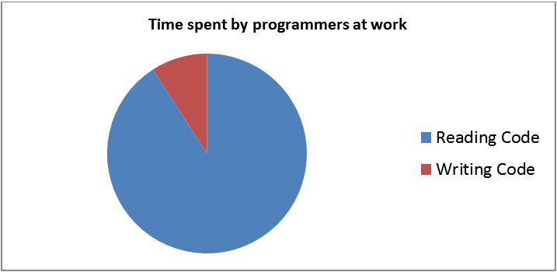
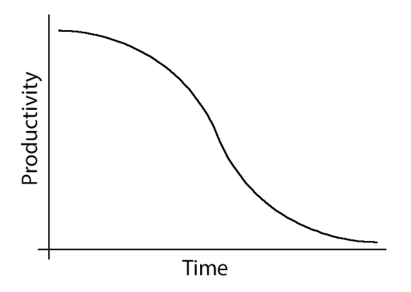
Why is Clean Code Important
Clean Code saves time
Maintains fast productivity
To make next developer Happier

Slide 6
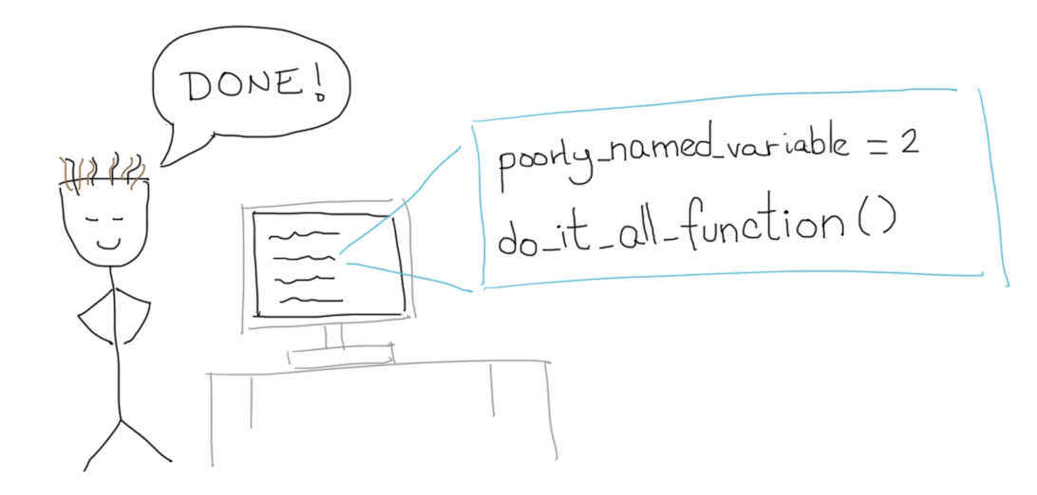
Why is Clean Code Important
Every time you code like this you make a programmer cry

Slide 7
What Prevents Clean Code
Ignorance
Stubbornness
Short-Timer Syndrome
Arrogance
Job Security
Factor | Root Cause | Impact on Code
Ignorance | Lack of knowledge | Poor structure, bad practices
Stubbornness | Resistance to change | Inconsistent and outdated code
Short-Timer Syndrome | Lack of long-term commitment | Quick hacks, no maintainability
Arrogance | Ego-driven coding | Overcomplex, unreadable solutions
Job Security | Fear of replacement | Intentionally messy code

Slide 8
What Prevents Clean Code
Number one reason:
“I’ll clean it up later.”
Pro Tip: “Later” never comes.

Slide 9
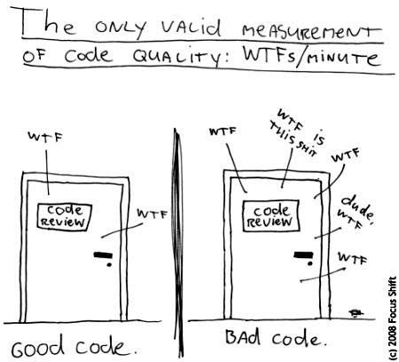
Measuring Code Quality

Slide 10
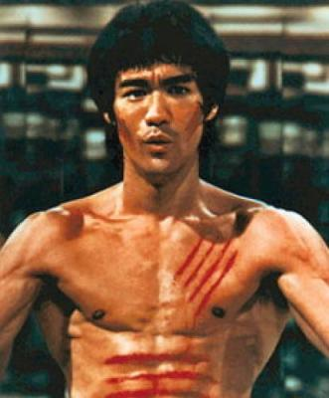
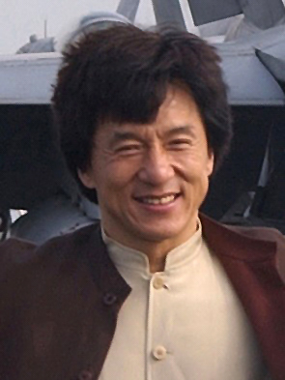
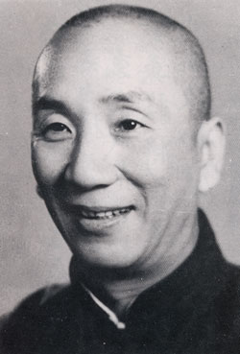


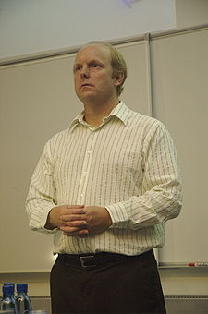
Writing Clean Code
Jeet Kune Do
Drunken Master?
Wing Chun
Code Complete
S.O.L.I.D
TDD
Just like martial arts has many masters with different styles, so does Clean Code

Slide 11
What Motivate Us to Write Clean Code
When Robert Baden-Powell, the founder of the Scout Movement, passed away in 1941 a famous letter was found in his drawer. It was addressed to the scouts of the world and contained a line which is now classic:
“Try and leave this world a little better than you found it.”
The Baden-Powell appeal can also serve as a guideline for developers –
”Leave the code cleaner than you found it!”

Slide 12
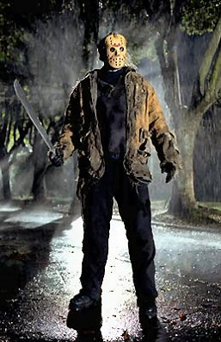
What Motivate Us to Write Clean Code
Another Rule of Thumb
“Imagine that the developer who comes after you is a violent psychopath who knows where you live.”

Slide 13
But How do We Do it???
Naming
Functions
Comments rules
Source code structure
Objects and data structures
Error Handling
Tests
Code smells

Slide 14
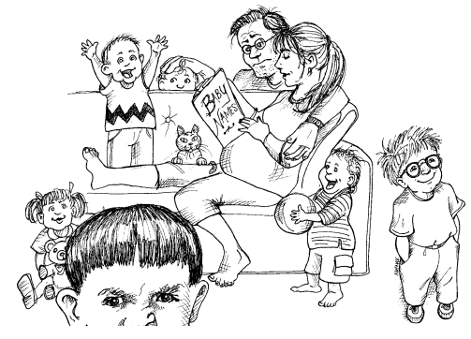
Naming: Use Intention-Revealing Names
Bad
int d; // elapsed time in days
Good
int elapsedTimeInDays;
int daysSinceCreation;
int daysSinceModification;
int fileAgeInDays;
Choosing good names takes time, but saves more than it takes. So take care with your names and change them when you find better ones.
If a name requires a comment, then the name does not reveals its intent.

Slide 15
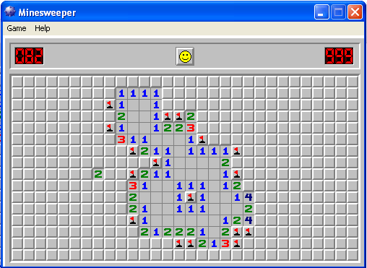
Naming : Use Intention-Revealing Names
Bad
public List<int[]> getThem() {
List<int[]> list1 = new ArrayList<int[]>();
for (int[] x : theList)
if (x[0] == 4)
list1.add(x);
return list1;
}
What is the content of the List1?
What is the significance of the item x[0] in the list?.
Why we compare x[0] vs 4?
How would i use the returned list?

Slide 16
Naming : Use Intention-Revealing Names
public List<int[]> getThem() {
List<int[]> list1 = new ArrayList<int[]>();
for (int[] x : theList)
if (x[0] == 4)
list1.add(x);
return list1;
}
Bad
What we have done:
Use intention revealing names
  flaggedCells rather than list1
Replaced magic numbers with constants cell[STATUS_VALUE] rather than x[0]
Good
public final static int STATUS_VALUE = 0;
public final static int FLAGGED = 4;
public List<int[]> getFlaggedCells() {
List<int[]> flaggedCells = new ArrayList<int[]>();
for (int[] cell : gameBoard)
if (cell[STATUS_VALUE] == FLAGGED)
flaggedCells.add(cell);
return flaggedCells;
}

Slide 17
Naming : Avoid Disinformation
Must avoid leaving false clues that obscure the meaning of code.
Should avoid words whose entrenched meaning vary from our intended meaning.
Don't refer to a group of accounts as "accountList," whereas it is actually not a List. Instead, name it "accountGroup," "accounts," or "bunchOfAccounts."
Avoid unnecessary encodings of datatypes along with the variable name.varies
String nameString;
Float salaryFloat;

Slide 18
Naming : Make meaningful Distinction
If there are two different things in the same scope, you might be tempted to change one name in an arbitrary way.
String cust;
What is stored in cust, which is different from customer?
String customer;
class ProductInfo
How are these classes different?
class ProductData
void getActiveAccount()
How do you differentiate between these methods in the same class?
void getActiveAccounts()
void getActiveAccountsInfo()
suggestion here is to make meaningful distinctions.

Slide 19
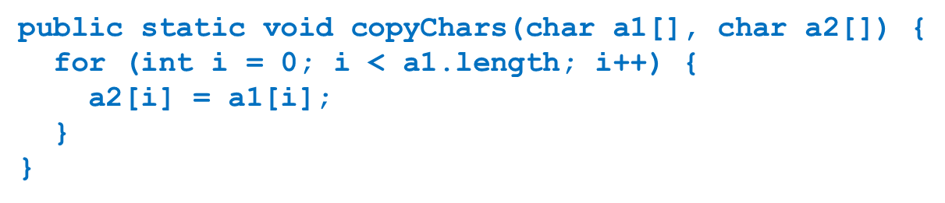
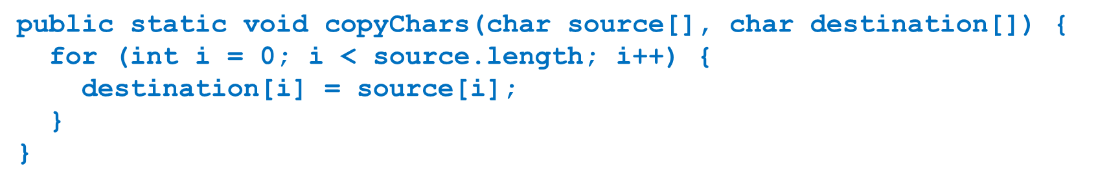
Naming : Make meaningful Distinction
the arguments are non-informative, a1 and a2 doesn't provide clues to the author intention.

Slide 20
Naming : Use Pronounceable Names
Ensure that names are pronounceable. Nobody wants a tongue twister.
class DtaRcrd102 {
private Date genymdhms;
private Date modymdhms;
private final String pszqint = "102";
};
Bad
class Customer {
private Date generationTimestamp;
private Date modificationTimestamp;
private final String recordId = "102";
};
Good

Slide 21
Naming : Use Searchable Names
Avoid single letter names and numeric constants, if they are not easy to locate across the body of the text.
for (int j = 0; j < 34; j++) {
s += (t[j] * 4) / 5;
}
Sum here is not really useful but at least is searchable.
It will be easier to find
WORKS_DAYS_PER_WEEK
than to find all the places where 5 was used.
int realDaysPerIdealDay = 4;
const int WORK_DAYS_PER_WEEK = 5;
int sum = 0;
for (int = 0; j < NUMBER_OF_TASKS; j++) {
int realTaskDays = taskEstimate[j] * realDaysPerIdealDay;
int realTaskWeeks = (realdays / WORK_DAYS_PER_WEEK);
sum += realTaskWeeks;
}

Slide 22
Naming : Don't Be Cute/Don't Use Offensive Words
If names are too clever, they will be memorable only to people who share your sense of humor, and only as long as these people remember the joke.
Will they know what the function named HolyHandGrenade is supposed to do?
Sure, it’s cute, but maybe in this case DeleteItems might be a better name.
Avoid using "HastaLaVistaBaby()" to mean "terminateProcess()" or "endExecution()". This is a famous quote from the Terminator movie series but can be confusing.
Say what you mean. Mean what you say.

Slide 23
Naming : Pick One Word per Concept
Use the same concept across the codebase.
FetchValue() vs GetValue() vs RetrieveValue()
If you are using fetchValue() to return a value of something, use the same concept; instead of using fetchValue() in all the code, using getValue(), retrieveValue() will confuse the reader.
dataFetcher() vs dataGetter() vs dataRetriver()
If all three methods do the same thing, don't mix and match across the code base. Instead, stick to one.

Slide 24
Naming : Don’t just Joke
This is exactly opposite of previous rule.
Avoid using the same word for two different purposes.
Using the same term for two different ideas is essentially pun.
For example, say you have two classes having the same add() method. In one class, it performs the addition of two values, in another, it inserts an element into a list. So, choose wisely; in the second class use insert() or append() instead of add()..

Slide 25
More on Naming
Class Names:
  Class names should be in CamelCase, starting with an uppercase letter.
  Use nouns or noun phrases for class names (e.g., Car, EmployeeRecord, AccountManager).
Interface Names:
  Interface names should be in CamelCase, starting with an uppercase letter.
  Use adjectives or adjective phrases for interface names (e.g., Serializable, runnable).
Method Names:
  Method names should be in camelCase, starting with a lowercase letter.
  Use verbs or verb phrases for method names (e.g., calculateTotal(), printReport()).

Slide 26
More on Naming
Constant Names:
  Constant names should be in uppercase with underscores separating words (e.g., MAX_VALUE, PI).
  Use all uppercase letters for constant names.
Method Parameters:
  Use meaningful and descriptive names for method parameters.
  Avoid single-letter parameter names like "a," "b," or "c.“
Getter and Setter Methods:
  Use the name of the property in the method name for getter and setter methods (e.g., getFirstName(), setLastName()).

Slide 27
Comments
“Don’t comment bad code—rewrite it.”
—Brian W. Kernighan and P. J. Plaugher
The best kind of comments are the ones you don't need

Slide 28
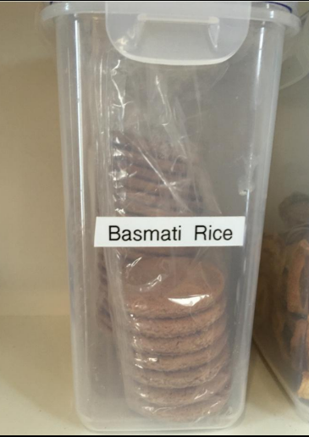
Comments
Rule #1: Comments lie
  Code is updated or moved, but not the comments.

Slide 29
Comments
Rule #2: Comments do not make up for bad code
  If the code is that unclear, rewrite the code
Rule #3: Explain yourself in Code
// Check to see if the employee is eligible for full benefits
if ((employee.flags & HOURLY_FLAG) && (employee.age > 65))
Should be
if (employee.isEligibleForFullBenefits())

Slide 30
Good Comments
Legal Comments
  We should write some legal comment like this to help another person know where and when the code come from
// Copyright (C) 2003,2004,2005 by Object Mentor, Inc. All rights reserved. // Released under the terms of the GNU General Public License version 2 or later.

Slide 31
Good Comments
Explanation of Intent
    assertTrue(a.compareTo(a) == 0); // a == a
    assertTrue(a.compareTo(b) != 0); // a != b
    assertTrue(ab.compareTo(ab) == 0); // ab == ab

Slide 32
Good Comments
Warning of Consequence
public static SimpleDateFormat makeStandardHttpDateFormat()
{
//SimpleDateFormat is not thread safe,
//so we need to create each instance independently.
SimpleDateFormat df = new SimpleDateFormat("EEE, dd MMM yyyy HH:mm:ss z");
df.setTimeZone(TimeZone.getTimeZone("GMT"));
return df;
}

Slide 33
Good Comments
TODO comments
  We should write TODO comment for note something that we will do in function
  // TODO: Add password hashing for better security
  public String hashPassword(String password) {
  // Incomplete code for password hashing
  // TODO: Implement a secure password hashing algorithm
  // This is just a placeholder and should be replaced
  return password;
  }

Slide 34
Good Comments
Amplification
  A comment may be used to amplify the importance of something that may otherwise seem insignificant.
public class OrderProcessingService {
public boolean processOrder(Order order) {
// Check if the customer has sufficient funds to place the order
if (order.getTotalAmount() > order.getCustomer().getAccountBalance()){
// The customer's account balance is insufficient to place the order.
// Consider implementing a notification or payment processing logic.
return false;
}
// Continue with order processing...
return true;
}
}

Slide 35
Good Comments
Attributions
  /*
  * Copyright (c) 2023 by John Doe
  * Licensed under the Apache License, Version 2.0 (the "License").
  * You may obtain a copy of the License at
  * http://www.apache.org/licenses/LICENSE-2.0
  */

Slide 36
Bad Comments
Mumbling
  Placing in a comment just because you feel you should or because the process requires it, is a hack.
  If you decide to write a comment, then spend the time necessary to make sure it is the best comment you can write. Example:
// This function calculates the sum of two numbers and returns the result
public int calculateSum(int a, int b) {
return a + b;
}
What is the necessity of this comment?

Slide 37
Bad Comments
Redundant Comments
// The method orchestrates the creation of an Employee by combining a person's name and a unique identifier to establish their identity.
public Employee(String name, int employeeID) {
this.name = name;
this.employeeID = employeeID;
}
What purpose does the comment serve?
It’s certainly not more informative than the code.
It is not easier to read than the code.

Slide 38
Bad Comments
Mandated Comments
  It is just plain silly to have a rule that says that every function must have a javadoc, or every variable must have a comment. Comments like this just mess up the code, propagate lies, and lend to general confusion and disorganization.
function hashIt(data) {
// The hash
let hash = 0;
// Length of string
const length = data.length;
// Loop through every character in data
for (let i = 0; i < length; i++) {
// Get character code.
const char = data.charCodeAt(i);
// Make the hash
hash = (hash << 5) - hash + char;
// Convert to 32-bit integer
hash &= hash;
}
}

Slide 39
Bad Comments
Journal Comments
  Remember, use version control! There's no need for dead code, commented code, and especially journal comments. Use git log to get history!
/**
* 2016-12-20: Removed monads, didn't understand them (RM)
* 2016-10-01: Improved using special monads (JP)
* 2016-02-03: Removed type-checking (LI)
* 2015-03-14: Added combine with type-checking (JR)
*/
function combine(a, b) {
return a + b;
}

Slide 40
Bad Comments
Noise Comments.
  /**
  * Default constructor.
  */
  protected AnnualDateRule() {
  }
  /** The day of the month. */
  private int dayOfMonth;
The comments in the above examples doesn't provides new information.
Position Markers
// Actions //////////////////////////////////
This type of comments are noising

Slide 41
Bad Comments
Don’t Use a Comment When You Can Use a Function or a Variable
// Calculate the total cost of items in the shopping cart
double totalCost = 0;
for (Item item : shoppingCart) {
totalCost += item.getPrice();
}
Can be modified using a function and a variable
double totalCost = calculateTotalCost(shoppingCart);
double calculateTotalCost(List<Item> shoppingCart) {
double totalCost = 0;
for (Item item : shoppingCart) {
totalCost += item.getPrice();
}
return totalCost;
}

Slide 42
Bad Comments
Closing Brace Comments
  try {
  while ((line = in.readLine()) != null) {
  lineCount++;
  charCount += line.length();
  String words[] = line.split("\\W");
  wordCount += words.length;
  } //while
  System.out.println("wordCount = " + wordCount);
  System.out.println("lineCount = " + lineCount);
  System.out.println("charCount = " + charCount);
  } // try
  catch (IOException e) {
  System.err.println("Error:" + e.getMessage());
  } //catch

Slide 43
Bad Comments
Commented-Out Code
  doStuff();
  // doOtherStuff();
  // doSomeMoreStuff();
  // doSoMuchStuff();
  VCS exists for a reason. Leave old code in your history.

Slide 44
Comment Summary
Always try to explain yourself in code.
Don't be redundant.
Don't add obvious noise.
Don't use closing brace comments.
Don't comment out code. Just remove.
Use as explanation of intent.
Use as clarification of code.
Use as warning of consequences.

Slide 45
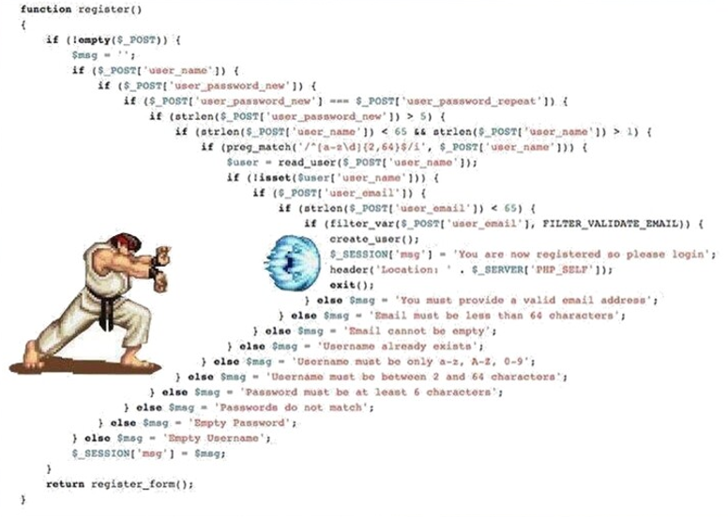
Formatting

Slide 46
Formatting Rules
Separate concepts vertically.
Related code should appear vertically dense.
Declare variables close to their usage.
Dependent functions should be close.
Similar functions should be close.
Keep lines short.
Don't use horizontal alignment.
Don't break indentation.
// Good
if (condition) {
doSomething();
}
// Bad
if (condition) {
doSomething();
}
public void processOrder() {
validateOrder();
saveOrder();
}
private void validateOrder() {
// Validation logic
}
private void saveOrder() {
// Save logic
}
int total = 0;
for (int i = 0; i < numbers.length; i++) {
total += numbers[i];
}
public int add(int a, int b) { return a + b; }
public int subtract(int a, int b) { return a - b; }
public int multiply(int a, int b) { return a * b; }
// Separate unrelated sections
int sum = a + b;
System.out.println("Hello, World!");
return result;
int result = computeSum(a, b);
System.out.println(result);
// Good
int x = 5;
double y = 10.5;
// Bad
int x = 5;
double y = 10.5;
// Good
String result = computeResult(input);
// Bad (too long)
String result = computeResultWithAdditionalProcessing(input, anotherInput, yetAnotherParameter);

Slide 47
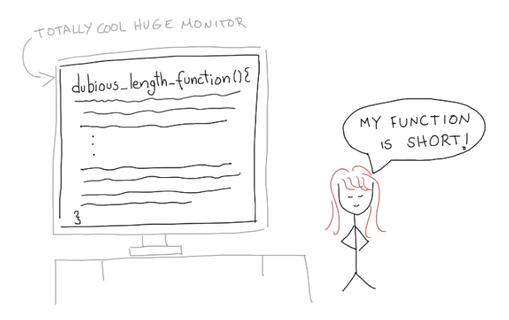
Functions
“I don’t understand how this code works”, “this code is a mess”, “it’s hard to modify this code”
If your function occupies a huge screen entirely, it doesn’t count as a short function

Slide 48
Functions
Several best practices on how to write plain, understandable functions
1. Functions should be small !!! Really
2. Block and indenting
3. Do one thing! (Single Responsibility Principle)
4. Function names should say what they do
5. Remove duplicate code
6. Avoid Side Effects
7. Remove dead code
8. One level of abstraction
9. Low number of arguments
10. Command Query Separation

Slide 49
Functions
1. Functions should be small !!! Really
1st rule – Function should be small.
2nd rule – Functions should be smaller than that!
Functions should barely be 20/30 lines long…
a shorter function will do less (only one simple thing).
Additionally to this, it will be more easily to understand and manage it.

Slide 50
Functions
2. Block and indenting
keep the code blocks inside if, else and while statements minimal.
preferably up to one line and that one line should be a function call
Similarly, we should avoid nesting such structures inside functions by moving the nested logic into another function.
The indent levels of a function probably shouldn’t be more than two tabs!

Slide 51
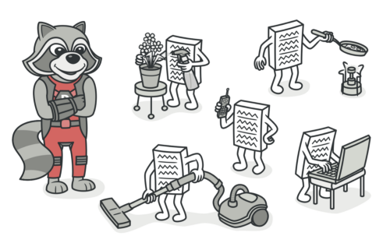
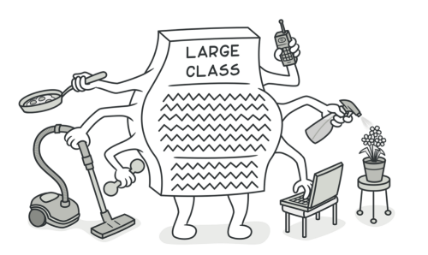
Functions
3. Do one thing! (Single Responsibility Principle)
“Functions should do one thing. They should do it well. They should do it only”.

Slide 52
Functions
4. Function names should say what they do
A function‘s name should explain what exactly it is doing. Nothing less, no more.
The name of a variable, function, or class, should answer the following:
  Why it exists?
  What does it do?
  How it is used?

Slide 53
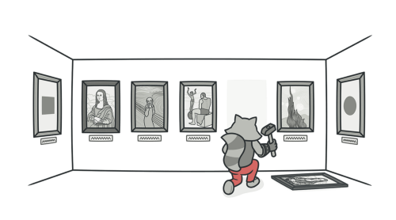
Functions
5. Remove duplicate code
attempt to prevent duplication of code.
If there is duplication of code, then you may need to change many places for a single change.

Slide 54
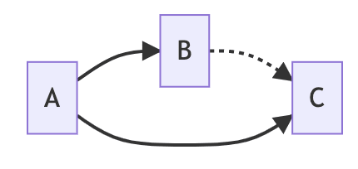
Functions
6. Avoid Side Effects
This is the case when your function is doing more than one thing, but without telling to the client.
In particular our functions should not create temporal coupling with other function
Temporal coupling is a kind of coupling where code is dependent on time in some way
After the task of the A component is completed, B and C must be executed. In addition, B is earlier than C.

Slide 55
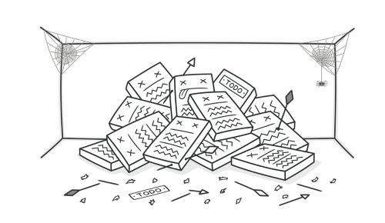
Functions
7. Remove dead code
Dead code is as poor as double code.
There’s nothing in the coding base to hold it.
If you ever need it, it will remain secure in your version history.

Slide 56
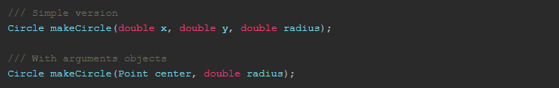
Functions
8. Low number of arguments
How much arguments should a perfect clean code function have?
Zero , monadic (1 argument), dyadic (2 arguments) or triads (3 arguments) functions.
Functions with more than 3 arguments should be avoided whenever possible.
When the number of arguments start to growth to more than 3 arguments it is possible wrap them in specific class that describe better their meaning.

Slide 57
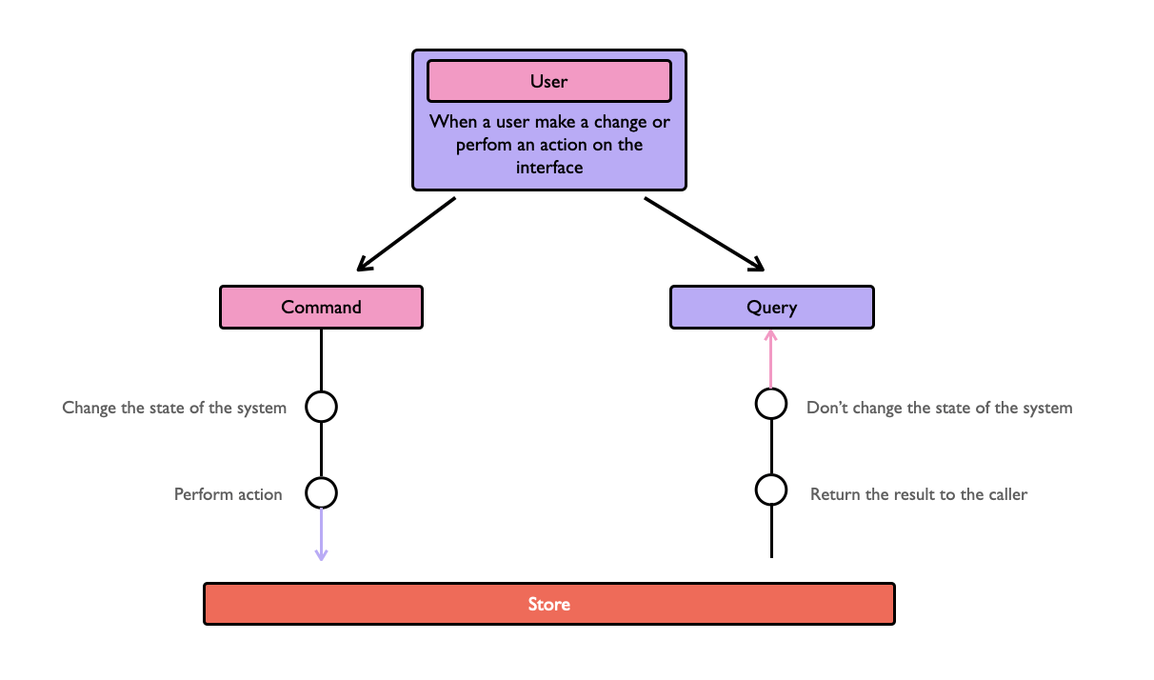
Functions
10. Command Query Separation
a method is either a COMMAND that performs an action OR a QUERY that returns data to the caller, but never both.
Doing both often leads to confusion.

Slide 58
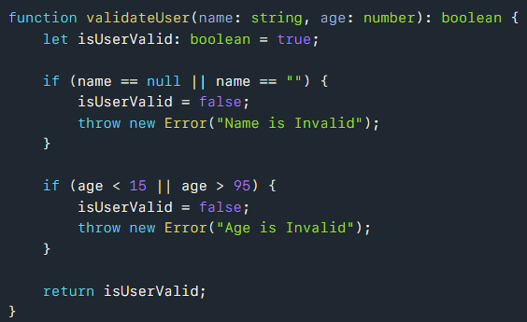
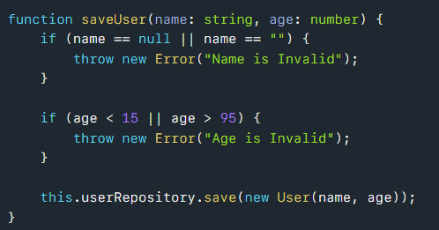

Functions
*. Command Query Separation
Query
Command

Slide 59
How do you make functions like this?
Revise Revise Revise!!!
Write your code first and start chopping away at it until you have something that follows the rules mentioned

Slide 60
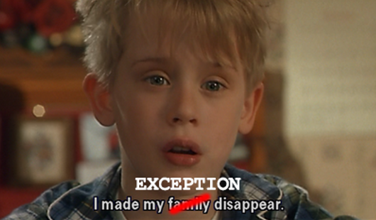
Exception & Error Handling
Things can go wrong, we as programmers are responsible for making sure that our codes does what it needs to do => and should be clear!

Slide 61
Exception & Error Handling
Returning an error code creates two additional things that need to be done by the developer/client.
Needs to know the mapping of each error code and at the same time he/she has to check the returning error code.
For these cases, throwing an exception is better and will simplify the work of clients.
Additional to this, the error handing will be 100% separated from your logic.

Slide 62
Error Handling Rules
Use Exceptions Rather Than Return Codes!
int withdraw(int amount) {
if (amount > _balance) {
return -1;
}
else {
balance -= amount;
return 0;
}
}
this method returns a special value that indicates an error
Throw an exception instead.
void withdraw(int amount) throws BalanceException {
if (amount > _balance) {
throw new BalanceException();
}
balance -= amount;
}

Slide 63
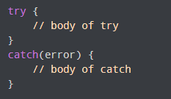
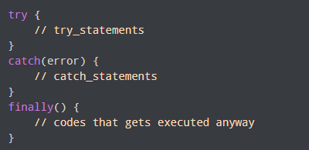
Error Handling Rules
Write Your Try-Catch-Finally Statement First
try {
// Code that might throw an exception
int result = 10 / 0; // This will throw ArithmeticException
} catch (ArithmeticException e) {
// Handling the specific exception
System.out.println("Cannot divide by zero.");
} finally {
// Code that runs regardless of exception
System.out.println("Execution completed.");
}
The main code is inside the try block. While executing the try block, if any error occurs, it goes to the catch block. The catch block handles the errors as per the catch statements.
If no error occurs, the code inside the try block is executed and the catch block is skipped
Your catch has to leave program in a consistent state, no matter what happens in the try.
For this reason, it is good practice to start with a try-catch-finally statement when you are writing code that could throw exceptions.
The finally block executes both when the code runs successfully or if an error occurs.

Slide 64
Error Handling Rules
Provide Context with Exceptions
Each exception that you throw should provide enough context to determine the source and location of an error.
Create informative error messages and pass them along with your exceptions.
Mention the operation that failed and the type of failure.
If you are logging in your application, pass along enough information to be able to log the error in your catch..

Slide 65
Error Handling Rules
Don't Return Null
If you are tempted to return null from a method, consider throwing an exception
If you are calling a null-returning method from a third-party API, consider wrapping that method with a method that either throws an exception
Don't Pass Null
Returning null from methods is bad but passing null into methods is worse.
Unless you are working with an API which expects you to pass null, you should avoid passing null in your code whenever possible.

Slide 66
FAQ: Exceptions and Error Handling
https://isocpp.org/wiki/faq/exceptions
Important contents with good explanation.
You must read it as you may get question form here in your coming exams….

Slide 67
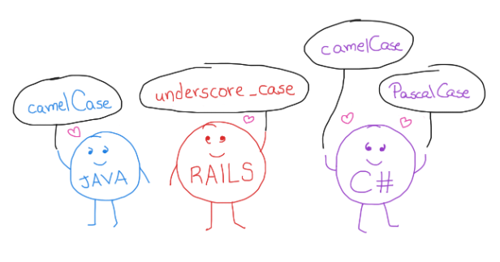
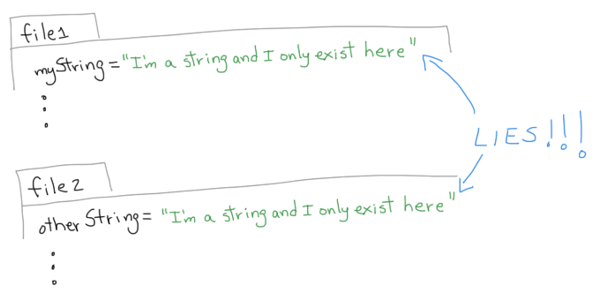
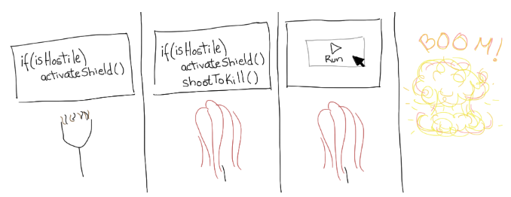
Techniques That Every Coder Should Know
Keep It Simple
Understand your Code
Don’t Repeat yourself
Indent your code
Naming convention
Avoid Hard-Coded Strings
and Magic Numbers
Always Write the Braces Around Single Line Blocks
Good Comments are your best friends
Test run
Write Everything Code-Related in English
Practice your art

Slide 68
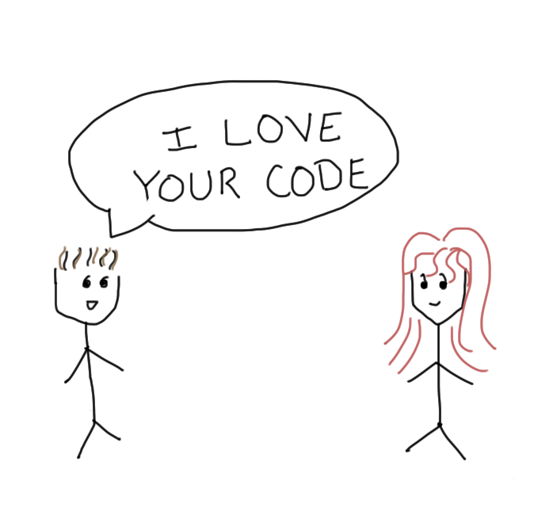
Make People Happy with your Code
Through your code, you have the power to affect the life of your fellow programmers:
They will rejoice/panic when they know they have to work with the code you wrote.
They will spend 10 minutes/1 hour understanding the code you wrote.
They will introduce 0 bugs/2 bugs when they edit the code you wrote.

Slide 69
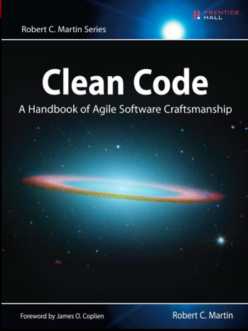

Useful Books

Slide 70
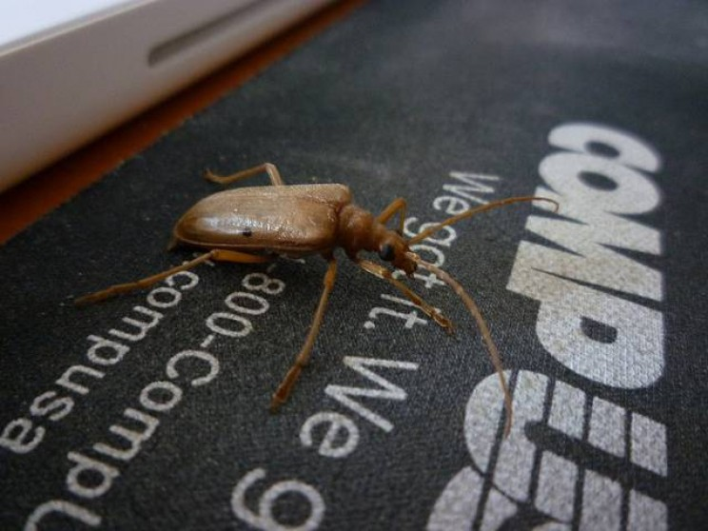
Debugging and Unit Testing

Slide 71
What is a Computer Bug
a bug refers to an error, fault or flaw in any computer program or a hardware system.
produces unexpected results or causes a system to behave unexpectedly.
In short, it is any behavior or result that a program or system gets but it was not designed to do.
From a developer perspective, bugs can be syntax or logic errors within the source code of a program.
These errors can often be fixed using a development tool suitably named a debugger.

Slide 72
first "Computer Bug"
the very first instance of a computer bug was recorded at 3:45 pm (15:45) on the 9th of September 1947.
It was a moth, and it’s been preserved behind some adhesive tape for nearly 70 years.
U.S. Navy officer, Grace Hopper, a member of Harvard’s programming team working on the Mark II Aiken Relay Calculator, was working late at night with the windows opened (no screens). The moth—roughly four inches in wingspan—was attracted by the light of the room and heat of the calculator and settled its way into the machine…where it was beaten to death by one of the relays.
Hopper’s team took the bug out of the relay, taped it to their logbook and labeled it as the “first actual case of a bug being found.”

Slide 73
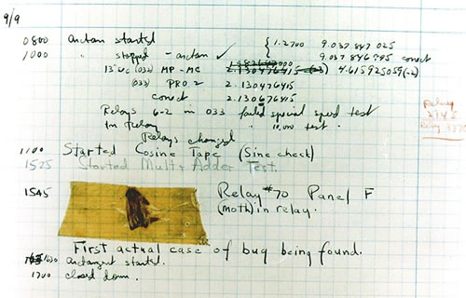
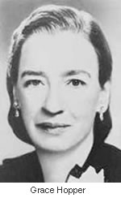
Grace Hopper
The very first recorded computer bug

Slide 74
Most of the art of programming is debugging
Bugs are always present in large applications.
Most of a software life cycle is in the support phase, so debugging saves big money!

Slide 75
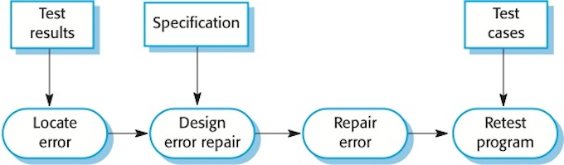
What is debugging?
Debugging is the process of finding and resolving defects or problems within a computer program that prevent correct operation of computer software or a system.
~Wikipedia
The debugging process

Slide 76
Debugging Process
Identifying the bug
  Example: A user reports that the application crashes when they click a specific button.
Reproducing the issue
  Example: Developers try to recreate the issue by following the user's steps.
Isolating the problematic code
  Example: By narrowing down the code, you identify the button's click event handler.
Analyzing the code
  Example: You review the code, checking for potential issues like null references.
Fixing the bug
  Example: You identify that a null object was accessed and correct the issue.
Testing the fix
  Example: After the fix, the application no longer crashes, and the button works as expected.

Slide 77
Debugging Tools
IDEs like Visual Studio provide debugging features like breakpoints and variable inspection.
Debuggers allow you to step through code and examine variables.

Slide 78
Debugging Techniques
Print statements
  Example: Adding Console.WriteLine statements to trace program flow.
Breakpoints
  Example: Setting a breakpoint in the code to pause execution at a specific point.
Logging
  Example: Using log files to record events, errors, and variables during program execution.
Unit testing
  Example: Writing unit tests to verify the correctness of individual functions or methods.

Slide 79
Rules to Remember
If you are lost or confused, randomly changing things around in code will not help
You cannot fix the error if you don’t know roughly where it is!
Errors can only be caught and fixed by debugging in a systematic fashion
The unfortunate news is that sometimes it’s almost impossible to figure out some problems through debugging..

Slide 80
Debugging Strategies…

Slide 81
Strategy #1: Debug with Purpose
Don't just change code and “hope” you'll fix the problem!
Instead, make the bug reproducible, then use methodical “Hypothesis Testing”:
While(bug) {
    Ask, what is the simplest input that produces the bug?
    Identify assumptions that you made about program operation that could be false.
    Ask yourself “How does the outcome of this test/change guide me toward finding the problem?”
    Use pen & paper to stay organized!
  }

Slide 82
Strategy #2: Explain it to Someone Else
  Often explaining the bug to “someone” unfamiliar with the program forces you to look at the problem in a different way.

Slide 83
Strategy #3: Focus on Recent Changes
  If you find a NEW bug, ask:
  what code did I change recently?
  This favours:
    writing and testing code incrementally
    using ‘svn/git diff' to see recent changes
    regression testing (making sure new changes don't break old code).

Slide 84
strategy #4: When in doubt, dump state
  In complex programs, reasoning about where the bug is, can be hard, and stepping through in a debugger time-consuming.
Sometimes it’s easier to just “dump state” and scan through for what seems “odd”.
State Dump Output:
Debugging via State Dump: You can add a state dump to log detailed information:
Suppose you're debugging an e-commerce checkout process where the total amount is incorrect
public void processCheckout(Order order) {
double total = 0;
for (Item item : order.getItems()) {
double itemTotal = item.getPrice() * item.getQuantity();
total += itemTotal;
// Dump state
System.out.println("Item: " + item.getName());
System.out.println("Price: " + item.getPrice());
System.out.println("Quantity: " + item.getQuantity());
System.out.println("Item Total: " + itemTotal);
}
System.out.println("Final Total: " + total);
// Proceed with payment
}
Item: Laptop
Price: 1000.0
Quantity: 1
Item Total: 1000.0
Item: Mouse
Price: 20.0
Quantity: -1
Item Total: -20.0
Final Total: 980.0
public void processCheckout(Order order) {
double total = 0;
for (Item item : order.getItems()) {
total += item.getPrice() * item.getQuantity();
}
System.out.println("Total: " + total);
// Proceed with payment
}
Issue: Users report that sometimes the total amount is wrong.
Analysis: The issue becomes apparent: negative quantities are causing the total to decrease. This would not have been obvious without dumping state.
Notes:
This helps you build an intuition for the flow in your program…

Slide 85
strategy #4: When in doubt, dump state
  tools for analyzing dump states include:
  GDB: The GNU Debugger is a powerful open-source debugger for analyzing crash dumps, attaching to live processes, and debugging code.
  WinDbg: A Windows Debugger from Microsoft, used for debugging Windows applications and system components. It is particularly useful for analyzing Windows crash dumps.
  ProcDump: A Windows tool from Sysinternals that is commonly used to capture process dumps when specific conditions are met.
  Java Diagnostic Tools: For Java applications, tools like jmap, jstack, and profilers like VisualVM are often used for diagnosing issues.
  Crashlytics (by Firebase): A popular crash reporting tool for mobile app development, which automatically captures crash dumps and provides analysis.
Notes:
This helps you build an intuition for the flow in your program…

Slide 86
Strategy #5: Get some distance...
Sometimes, you can be TOO CLOSE to the code to see the problem.
Go for a run, take a shower, whatever relaxes you but let's your mind continue to spin in the background.

Slide 87
strategy #6: Let others work for you!
Sometimes, error detecting tools make certain bugs easy to find. We just have to use them.
- runtime tools to detect memory errors

Slide 88
Strategy #7: Think Ahead
Bugs often represent your misunderstanding of a software interface.
Once you've fixed a bug:
1) Smile and do a little victory dance....
2) Think about if the bug you fixed might manifest itself elsewhere in your code.
3) Think about how to avoid this bug in the future
(maybe coding 36 straight hours before the deadline isn't the most efficient approach....)

Slide 89
Final words
Debugging is one of the more frustrating parts of programming. It has elements of problem solving or brain teasers, coupled with the annoying recognition that you have made a mistake…
Don’t be afraid to ask your fellow
mates! for debugging help.

Slide 90
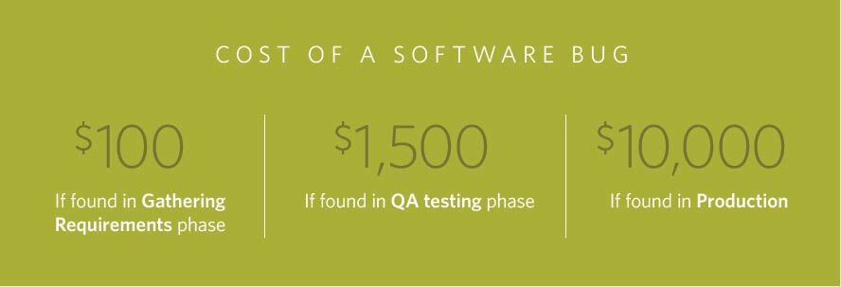
The rising cost of fixing a bug
What do you think fixing a bug would cost on average?
It depends on how late you find it..
The Systems Sciences Institute at IBM has reported that
  “the cost to fix an error found after product release was four to five times as much as one uncovered during design, and up to 100 times more than one identified in the maintenance phase.”
Considering these numbers, surely it’s better to find out about such issues as soon as you possibly can!

Slide 91
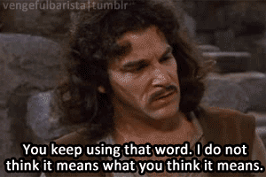
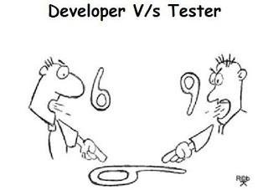
Unit Testing
Testing helps increase our confidence in our code - “If it isn’t tested, assume it doesn’t work”

Slide 92
What is unit testing
The testing that programmers do is generally called unit testing.
but we prefer not to use this term.
A unit test is a piece of code that invokes a unit of work and checks one specific end result of that unit of work. If the assumptions on the end result turn out to be wrong, the unit test has failed.
Unit testing is understood as testing small parts of the code in isolation.
The unit under consideration might be getting some inputs from another unit or the unit is calling some other unit. It means that a unit is not independent and cannot be tested in isolation.
While testing a unit, all its interfaces must be simulated if the interfaced units are not ready at the time of testing the unit under consideration.

Slide 93
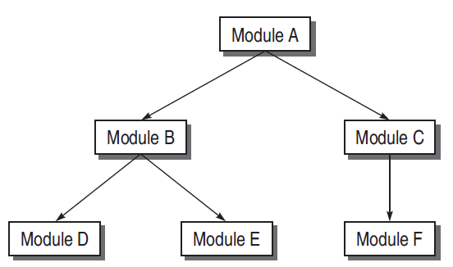
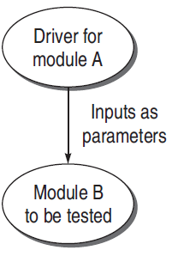
Thing to know
Driver:
  Sometimes unit to be tested need input form other unit/module and that unit may not be implemented or under development
  In such a situation, we need to simulate the inputs required in the module to be tested.
  This module where the required inputs for the module under test are simulated for the purpose of module or unit testing is known as a driver module.
Suppose module A is not ready and B has to be unit tested. In this case, module B needs inputs from module A. Therefore, a driver
module is needed which will simulate module A in the sense that it passes the required inputs to module B

Slide 94
Thing to know
  A test driver may take inputs in the following form and call the unit to be tested:
    It may hard-code the inputs as parameters of the calling unit.
    It may take the inputs from the user.
    It may read the inputs from a file.
  A test driver provides the following facilities to a unit to be tested:
    Initializes the environment desired for testing.
    Provides simulated inputs in the required format to the units to be tested.

Slide 95
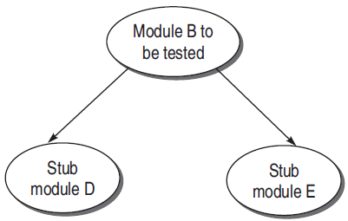
Thing to know
Stubs:
  The module under testing may also call some other module which is not ready at the time of testing.
  these modules also need to be simulated for testing..
  For this dummy modules are prepared which is known as stubs.
Module B under test needs to call module D and module E. But they are not ready. So there must be some skeletal structure in their place so that they act as dummy modules in place of the actual modules. Therefore, stubs need to be designed for module D and module E

Slide 96
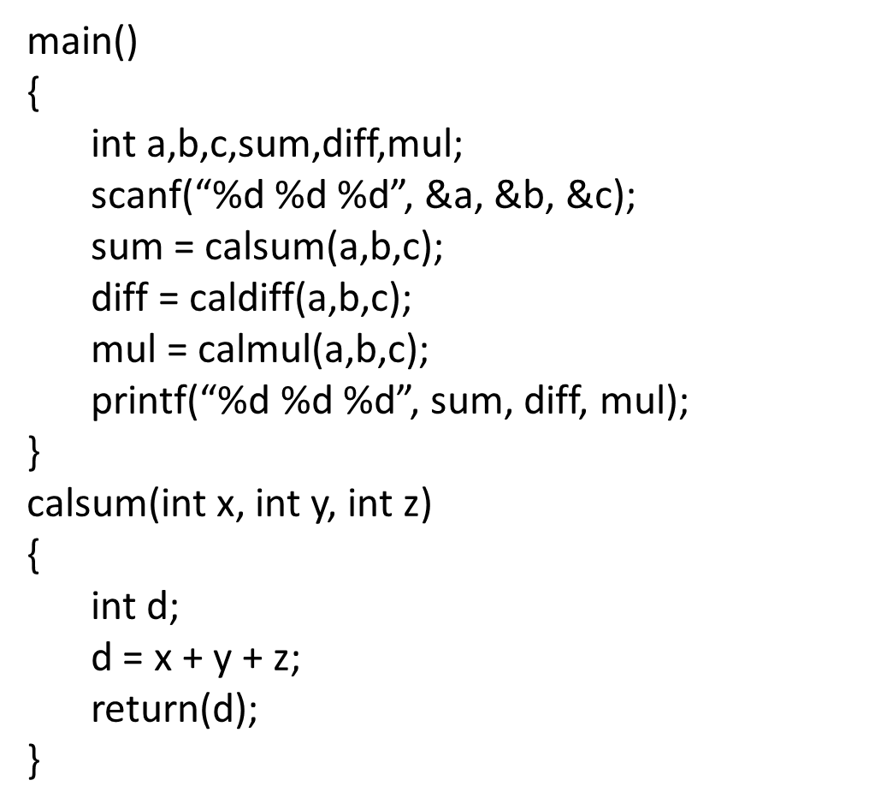
Example
(a) Suppose main() module is not ready for the testing of calsum() module.
Design a driver module for main().
(b) Modules caldiff() and calmul() are not ready when called in main().
Design stubs for these two modules.

Slide 97
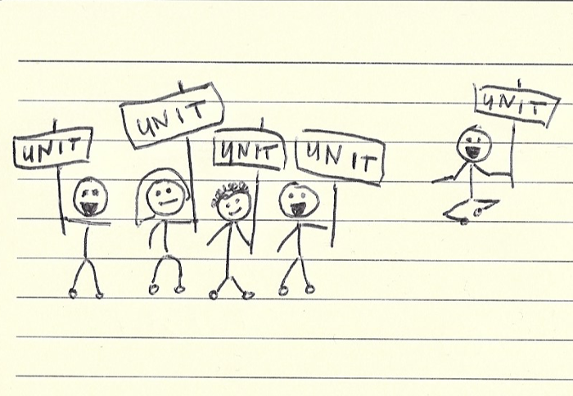
How to identify a unit?
It’s entirely up to us!
There are no hard and fast rules for this.
We can consider a bunch of functions as one unit or test a single function as a separate unit.
But We can use a very simple rule:
If a unit proves difficult to test, then it’s very likely that it needs to be broken down into smaller components.

Slide 98
Properties of a good unit test
A unit test should have the following properties:
It should be easy to implement.
Anyone should be able to run it at the push of a button.
It should run quickly.
It should be consistent in its results (it always returns the same result if you don’t change anything between runs).
It should have full control of the unit under test.
It should be fully isolated (runs independently of other tests).
When it fails, it should be easy to detect what was expected and determine how to pinpoint the problem.

Slide 99
Writing Good Tests
Goal: to expose problems!
  Assume role of an adversary
  Failure == success
Test boundary conditions
  0, Integer.MAX_VALUE, empty array
Test different categories of input
  positive, negative, and zero
Test different categories of behavior
  each menu option, each error message
Test “unexpected” input
  null pointer, last name includes a space
Test representative “normal” input
  random, reasonable values

Slide 100
EXCUSES FOR NOT TESTING
It takes too long to run the tests
It's not my job to test my code
I don't really know how the code is supposed to behave so I can't test it
But it compiles!
I'm being paid to write code, not to write tests
I feel guilty about putting testers and QA staff out of work
My company won't let me run unit tests on the live system

Slide 101
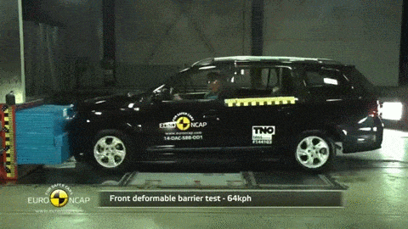
The big Excuse
Tests are expensive to write
Yes, testing is expensive in most of industries: think about testing a home appliance, a drug or a new car…
Test are costly
They do require extra effort,
but they improve quality, bring fast feedback, secure knowledge for newcomers…

Slide 102
Your First Unit Tests
To check if code is behaving as you expect, you use an assertion, a simple method call that verifies that something is true.
For instance, the method assertTrue checks that the given boolean condition is true, and fails the current test if it is not.
You could use this assert to check all sorts of things, including whether numbers are equal to each other:
It might be implemented like the following.
public void assertTrue(boolean condition) {
if (!condition) {
abort();
}
}
int a = 2;
assertTrue(a == 2);
If for some reason a does not equal 2 when the assertTrue() is called, then the program will abort.

Slide 103
Your First Unit Tests
To check that two integers are equal, for instance, we could write a method that takes two integer parameters:
public void assertEquals(int a, int b) { assertTrue(a == b);
}

Slide 104
TESTING A SIMPLE METHOD
We'll start with a simple example, a single, static method designed to find the largest number in a list of numbers:
int Largest.largest(int[] list);
In other words, given an array of numbers such as [7, 8,9], this method should return 9.
That's a reasonable first test.
Think about more cases….

Slide 105
TESTING A SIMPLE METHOD
How many tests did you come up with?
Your test cases should be as “What you pass in” → “What you expect”
[7, 8, 9] → 9
[8, 7, 9] → 9
[9, 7, 8] → 9
What happens if there are duplicates:
[7, 9, 8, 9] → 9
What happens if there is only one number:
[1] → 1
What happens with negative numbers:
[-7, -9, -8, -9] → -7
To make all this more concrete, lets write a “largest” method and test it.

Slide 106
TESTING A SIMPLE METHOD
public class Largest {
/**
* Return the largest element in a list.
* @param list A list of integers
* @return The largest number in the given list
*/
public static int largest(int[] list) {
int index, max=Integer.MAX_VALUE;
for (index = 0; index < list.length-1; index++)
if (list[index] > max) {
max = list[index];
}
}
return max;
}
}
Now that we've got some ideas for tests, we'll look at writing these tests in Java, using the JUnit framework.

Slide 107
TESTING A SIMPLE METHOD
First, let's just test the simple case of passing in a small array with a couple of unique numbers. Here's the complete source code for the test class.
import junit.framework.*;
public class TestLargest extends TestCase {
public TestLargest(String name) {
super(name);
}
public void testSimple() {
assertEquals(9, Largest.largest(new int[] {7,8,9}));
}
}

Slide 108
TESTING A SIMPLE METHOD
Having just run that code, you probably saw an error similar to the following:
There was 1 failure:
1) testSimple(TestLargest)junit.framework.AssertionFailedError:
expected:<9> but was:<2147483647>
at TestLargest.testSimple(TestLargest.java:11)
Whoops! That is not expected. Why does it return such a huge number instead of 9?
oh, it's a small typo: max=Integer.MAX VALUE on line 11 should have been max=0. We want to initialize max so that any other number instantly becomes the next max. Let’s fix the code, recompile, and run the test again to make sure that it works.

Slide 109
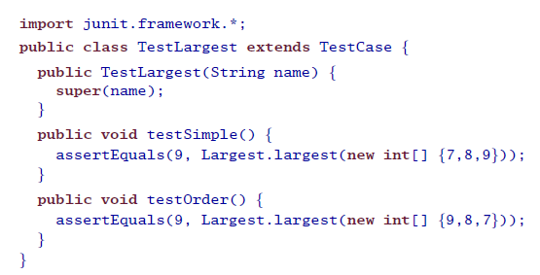
TESTING A SIMPLE METHOD
Next we'll look at what happens when the largest number appears in different places in the list first or last, and somewhere in the middle.
it works☺

Slide 110
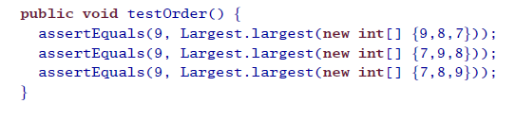


TESTING A SIMPLE METHOD
One more, just for the sake of completeness, and we can move on to more interesting tests:
Now try it with the 9 in the middle (just add an additional assertion the
existing testOrder() method):
it works☺
Why did the test get an 8 as the largest number?

Slide 111

TESTING A SIMPLE METHOD
Why did the test get an 8 as the largest number?
It seems the code ignored the last entry in the list. Sure enough, another simple typo: the for loop is terminating too early.
Our code has:
But it should be one of :

Slide 112


TESTING A SIMPLE METHOD
Now you can check for duplicate largest values:
Now the test for just a single integer:
it works☺
it works☺
We are almost done except the negative test

Slide 113


TESTING A SIMPLE METHOD
Now you can check for Negative values:
How is the actual result zero?
Looks like choosing 0 to initialize max was a bad idea; what we really wanted was MIN VALUE, so as to be less than all negative numbers as well:

Slide 114
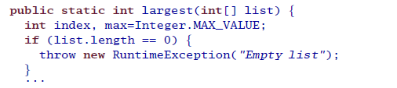
TESTING A SIMPLE METHOD
Unfortunately, the initial specification for the method “largest” is incomplete, as it does not says what should happen if the array is empty.
We need to handle that…
Let's say that it's an error, and add some code at the top of the method that will throw a runtime-exception if the list length is zero:
Now for the last test, we need to check that an exception is thrown when passing in an empty array.

Slide 115
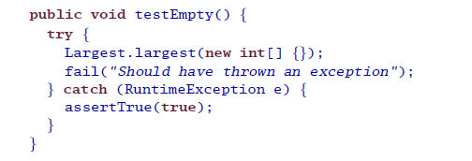
TESTING A SIMPLE METHOD
it works☺
We started with a very simple method and come up with a couple of interesting tests that actually found some bugs.

Slide 116
Unit Testing Best Practices
Unit Test cases should be independent. In case of any enhancements or change in requirements, unit test cases should not be affected.
Test only one code at a time.
Follow clear and consistent naming conventions for your unit tests
In case of a change in code in any module, ensure there is a corresponding unit Test Case for the module, and the module passes the tests before changing the implementation
Bugs identified during unit testing must be fixed before proceeding to the next phase in SDLC

Slide 117

Why Good Developers Write Bad Unit Tests
Utilize 15 mins to read :
https://mtlynch.io/good-developers-bad-tests/

Slide 118
Quiz [Write your Student ID and Course Code]
ABC Bank wants to develop a Mobile wallet for its clients. They already have more than a million users, and their service should be up 99.98% time. If the service is not available, the users should get a notification immediately. Also, the app should respond in less than a second for any users’ request. In any situation, if the app fails to response the app should provide proper error message to the user. The CPU usage of the app should not be more than 15%, and memory consumption should be less than 20 MB. They want your company to develop a mobile wallet for them, which will have all the existing features of their internet banking and they also want to add many new features. The new features have not yet been decided. And ABC bank wants to observe the progress of development in every 2 weeks.
  Under these circumstances, which Software development model will you choose to complete the development? Briefly mention all the events related to your chosen model. (3 + 12)
  Identify five non-functional requirements mentioned in the above scenario. (5)

